Slide 1
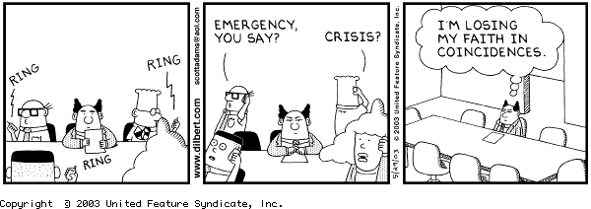
Chapter 7:
Project Quality Management

Slide 2
Quality of Information Technology Projects
Many people joke about the poor quality of IT products
People seem to accept systems being down occasionally or needing to reboot their PCs
But quality is very important in many IT projects

Slide 3
What Is Project Quality Management?
The International Organization for Standardization (ISO) defines quality as the totality of characteristics of an entity that bear on its ability to satisfy stated or implied needs
Other experts define quality based on
  conformance to requirements: meeting written specifications
  fitness for use: ensuring a product can be used as it was intended

Slide 4
Quality Experts
Deming was famous for his work in rebuilding Japan and his 14 points
Juran wrote the Quality Control Handbook and 10 steps to quality improvement
Crosby wrote Quality is Free and suggested that organizations strive for zero defects
Ishikawa developed the concept of quality circles and using fishbone diagrams
Taguchi developed methods for optimizing the process of engineering experimentation
Feigenbaum developed the concept of total quality control

Slide 5
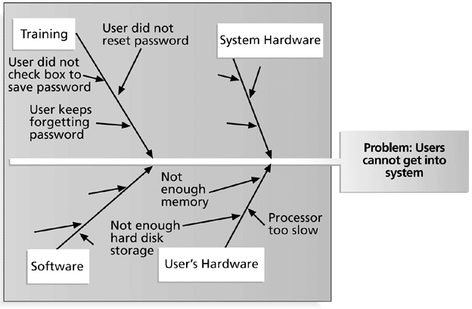
Figure 7-1. Sample Fishbone or Ishikawa Diagram

Slide 6
Modern Quality Management
Modern quality management
  requires customer satisfaction
  prefers prevention to inspection
  recognizes management responsibility for quality
Noteworthy quality experts include Deming, Juran, Crosby, Ishikawa, Taguchi, and Feigenbaum

Slide 7
Project Quality Management Processes
Quality planning: identifying which quality standards are relevant to the project and how to satisfy them
Quality assurance: evaluating overall project performance to ensure the project will satisfy the relevant quality standards
Quality control: monitoring specific project results to ensure that they comply with the relevant quality standards while identifying ways to improve overall quality

Slide 8
Quality Planning
It is important to design in quality and communicate important factors that directly contribute to meeting the customer’s requirements
Design of experiments helps identify which variable have the most influence on the overall outcome of a process
Many scope aspects of IT projects affect quality like functionality, features, system outputs, performance, reliability, and maintainability

Slide 9
Quality Assurance
Quality assurance includes all the activities related to satisfying the relevant quality standards for a project
Another goal of quality assurance is continuous quality improvement
Benchmarking can be used to generate ideas for quality improvements
Quality audits help identify lessons learned that can improve performance on current or future projects

Slide 10
Quality Control
The main outputs of quality control are
  acceptance decisions
  rework
  process adjustments
Some tools and techniques include
  pareto analysis
  statistical sampling
  quality control charts
  testing

Slide 11
Pareto Analysis
Pareto analysis involves identifying the vital few contributors that account for the most quality problems in a system
Also called the 80-20 rule, meaning that 80% of problems are often due to 20% of the causes
Pareto diagrams are histograms that help identify and prioritize problem areas

Slide 12
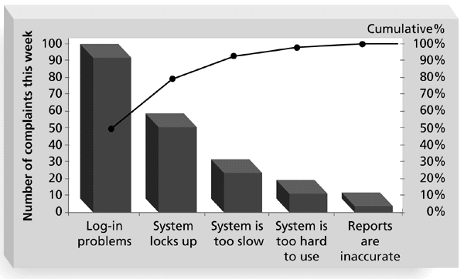
Figure 7-2. Sample Pareto Diagram

Slide 13
Statistical Sampling and Standard Deviation
Statistical sampling involves choosing part of a population of interest for inspection
The size of a sample depends on how representative you want the sample to be
Sample size formula:
Sample size = .25 X (certainty Factor/acceptable error)²

Slide 14

Table 7-1. Commonly Used Certainty Factors
95% certainty: Sample size = 0.25 X (1.960/.05) ² = 384
90% certainty: Sample size = 0.25 X (1.645/.10)² = 68
80% certainty: Sample size = 0.25 X (1.281/.20)² = 10

Slide 15
Standard Deviation
Standard deviation measures how much variation exists in a distribution of data
A small standard deviation means that data cluster closely around the middle of a distribution and there is little variability among the data
A normal distribution is a bell-shaped curve that is symmetrical about the mean or average value of a population

Slide 16
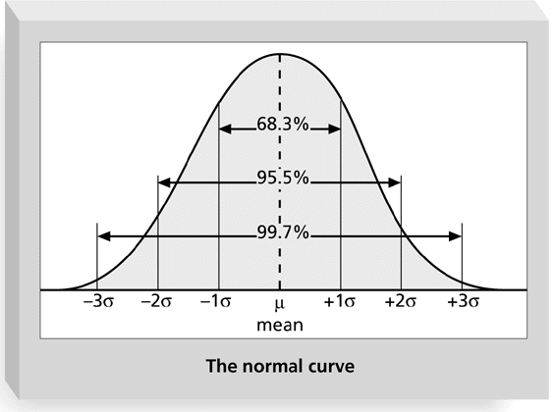
Figure 7-3. Normal Distribution and Standard Deviation

Slide 17
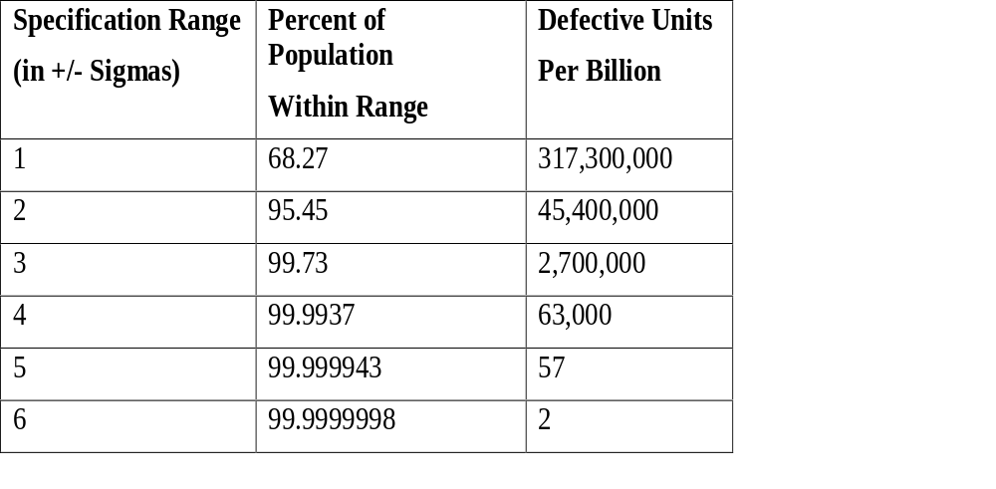
Table 7-2. Sigma and Defective Units
Note: “Six sigma” often refers to +/-3 sigma, meaning
2.7 million defects per billion units produced, or 2.7
defects per million.

Slide 18
Quality Control Charts, Six Sigma, and the Seven Run Rule
A control chart is a graphic display of data that illustrates the results of a process over time. It helps prevent defects and allows you to determine whether a process is in control or out of control
Operating at a higher sigma value, like 6 sigma, means the product tolerance or control limits have less variability
The seven run rule states that if seven data points in a row are all below the mean, above,the mean, or increasing or decreasing, then the process needs to be examined for non-random problems

Slide 19
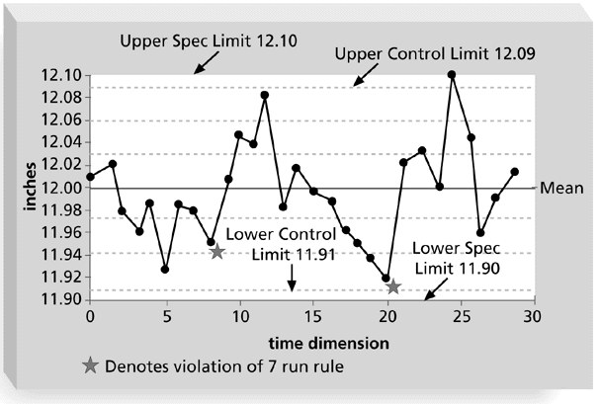
Figure 7-4. Sample Quality Control Chart

Slide 20
Testing
Many IT professionals think of testing as a stage that comes near the end of IT product development
Testing should be done during almost every phase of the IT product development life cycle

Slide 21
Types of Tests
A unit test is done to test each individual component (often a program) to ensure it is as defect free as possible
Integration testing occurs between unit and system testing to test functionally grouped components
System testing tests the entire system as one entity
User acceptance testing is an independent test performed by the end user prior to accepting the delivered system

Slide 22
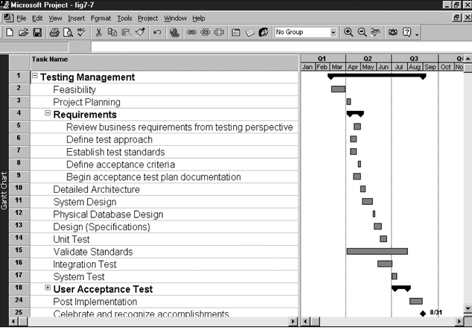
Figure 7-7. Gantt Chart for Building Testing into a Systems Development Project Plan

Slide 23
Improving Information Technology Project Quality
Several suggestions for improving quality for IT projects include
  Leadership that promotes quality
  Understanding the cost of quality
  Focusing on organizational influences and workplace factors that affect quality
  Following maturity models to improve quality

Slide 24
Leadership
“It is most important that top management be quality-minded. In the absence of sincere manifestation of interest at the top, little will happen below.” (Juran, 1945)
A large percentage of quality problems are associated with management, not technical issues

Slide 25
The Cost of Quality
The cost of quality is
  the cost of conformance or delivering products that meet requirements and fitness for use
  the cost of nonconformance or taking responsibility for failures or not meeting quality expectations

Slide 26
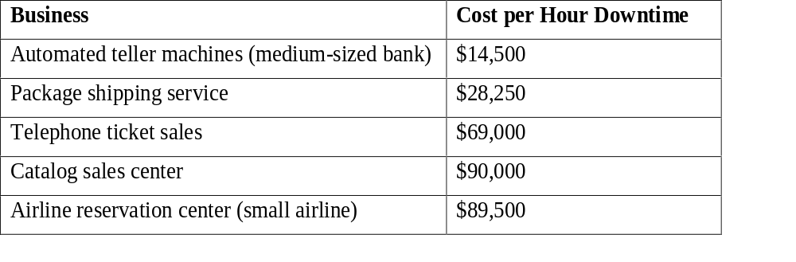
Table 7-3. Costs Per Hour of Downtime Caused by Software Defects

Slide 27
Five Cost Categories Related to Quality
Prevention cost: the cost of planning and executing a project so it is error-free or within an acceptable error range
Appraisal cost: the cost of evaluating processes and their outputs to ensure quality
Internal failure cost: cost incurred to correct an identified defect before the customer receives the product
External failure cost: cost that relates to all errors not detected and corrected before delivery to the customer
Measurement and test equipment costs: capital cost of equipment used to perform prevention and appraisal activities

Slide 28
Organization Influences, Workplace Factors, and Quality
Study by DeMarco and Lister showed that organizational issues had a much greater influence on programmer productivity than the technical environment or programming languages
Programmer productivity varied by a factor of one to ten across organizations, but only by 21% within the same organization
Study found no correlation between productivity and programming language, years of experience, or salary
A dedicated workspace and a quiet work environment were key factors to improving programmer productivity

Slide 29
Maturity Models
Maturity models are frameworks for helping organizations improve their processes and systems
  Software Quality Function Deployment Model focuses on defining user requirements and planning software projects
  The Software Engineering Institute’s Capability Maturity Model provides a generic path to process improvement for software development
  Several groups are working on project management maturity models

Slide 30
Project Management Maturity Model
1. Ad-Hoc: The project management process is described as disorganized, and occasionally even chaotic. The organization has not defined systems and processes, and project success depends on individual effort. There are chronic cost and schedule problems.
2. Abbreviated: There are some project management processes and systems in place to track cost, schedule, and scope. Project success is largely unpredictable and cost and schedule problems are common.
3. Organized: There are standardized, documented project management processes and systems that are integrated into the rest of the organization. Project success is more predictable, and cost and schedule performance is improved.

Slide 31
Project Management Maturity Model
4. Managed: Management collects and uses detailed measures of the effectiveness of project management. Project success is more uniform, and cost and schedule performance conforms to plan.
5. Adaptive: Feedback from the project management process and from piloting innovative ideas and technologies enables continuous improvement. Project success is the norm, and cost and schedule performance is continuously improving.

Slide 32
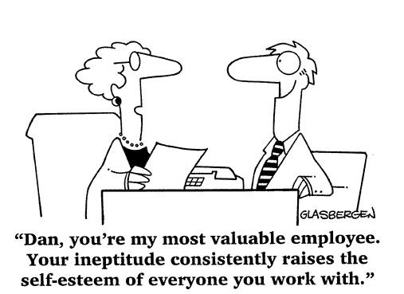
Chapter 8:
Project Human Resource Management

Slide 33
Human Resource Management
People determine the success and failure of organizations and projects
Despite the downturn in the economy in 2001, there is still a shortage of good IT workers
  ITAA calculated that there were over 844,000 openings for IT jobs in 2000
  1 in 14 American workers are involved in IT jobs
  Although women represent 47 percent of the work force, they make up only 29 percent of IT jobs

Slide 34
Long Hours and Stereotypes of IT Workers Hurt Recruiting
Many people are struggling with how to increase the IT labor pool. Noted problems include
  The fact that many IT professionals work long hours and must constantly stay abreast of changes in the field
  Undesirable stereotypes that keep certain people away from the career field, like women
  The need to improve benefits, redefine work hours and incentives, and provide better human resource management

Slide 35
What is Project Human Resource Management?
Project human resource management includes the processes required to make the most effective use of the people involved with a project. Processes include
  Organizational planning
  Staff acquisition
  Team development

Slide 36
Keys to Managing People
Psychologists and management theorists have devoted much research and thought to the field of managing people at work
Important areas related to project management include
  motivation
  influence and power
  effectiveness

Slide 37
Motivation
Abraham Maslow developed a hierarchy of needs to illustrate his theory that people’s behaviors are guided by a sequence of needs
Maslow argued that humans possess unique qualities that enable them to make independent choices, thus giving them control of their destiny

Slide 38
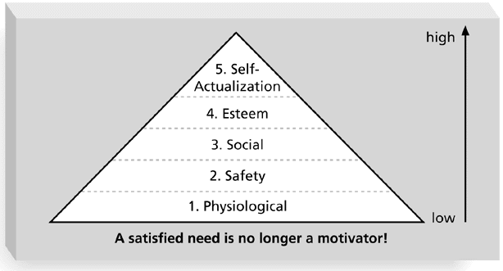
Maslow’s Hierarchy of Needs

Slide 39
Herzberg’s Motivational and Hygiene Factors
Frederick Herzberg wrote several famous books and articles about worker motivation. He distinguished between
  motivational factors: achievement, recognition, the work itself, responsibility, advancement, and growth, which produce job satisfaction
  hygiene factors: cause dissatisfaction if not present, but do not motivate workers to do more. Examples include larger salaries, more supervision, and a more attractive work environment

Slide 40
McGregor’s Theory X and Y
Douglas McGregor popularized the human relations approach to management in the 1960s
Theory X: assumes workers dislike and avoid work, so managers must use coercion, threats and various control schemes to get workers to meet objectives
Theory Y: assumes individuals consider work as natural as play or rest and enjoy the satisfaction of esteem and self-actualization needs
Theory Z: introduced in 1981 by William Ouchi and is based on the Japanese approach to motivating workers, emphasizing trust, quality, collective decision making, and cultural values

Slide 41
Thamhain and Wilemon’s Ways to Have Influence on Projects
1. Authority: the legitimate hierarchical right to issue orders
2. Assignment: the project manager's perceived ability to influence a worker's later work assignments
3. Budget: the project manager's perceived ability to authorize others' use of discretionary funds
4. Promotion: the ability to improve a worker's position
5. Money: the ability to increase a worker's pay and benefits

Slide 42
Thamhain and Wilemon’s Ways to Have Influence on Projects
6. Penalty: the project manager's ability to cause punishment
7. Work challenge: the ability to assign work that capitalizes on a worker's enjoyment of doing a particular task
8. Expertise: the project manager's perceived special knowledge that others deem important
9. Friendship: the ability to establish friendly personal relationships between the project manager and others

Slide 43
Ways to Influence that Help and Hurt Projects
Projects are more likely to succeed when project managers influence with
  expertise
  work challenge
Projects are more likely to fail when project managers rely too heavily on
  authority
  money
  penalty

Slide 44
Power
Power is the potential ability to influence behavior to get people to do things they would not otherwise do
Types of power include
  Coercive
  Legitimate
  Expert
  Reward
  Referent

Slide 45
Empathic Listening and Rapport
Good project managers are empathic listeners; they listen with the intent to understand
Before you can communicate with others, you have to have rapport
Mirroring is a technique to help establish rapport
IT professionals often need to develop empathic listening and other people skills to improve relationships with users and other stakeholders

Slide 46
Improving Relationships Between Users and Developers
Some organizations require business people, not IT people, to take the lead in determining and justifying investments in new computer systems
CIOs push their staff to recognize that the needs of the business must drive all technology decisions
Some companies reshape their IT units to look and perform like consulting firms

Slide 47
Organizational Planning
Organizational planning involves identifying, documenting, and assigning project roles, responsibilities, and reporting relationships
Outputs and processes include
  project organizational charts
  work definition and assignment process
  resource histograms

Slide 48
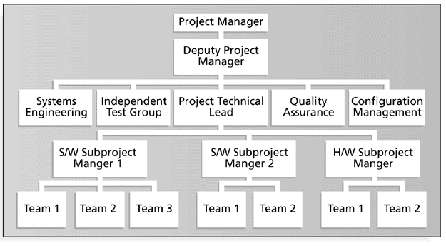
Sample Organizational Chart for a Large IT Project

Slide 49
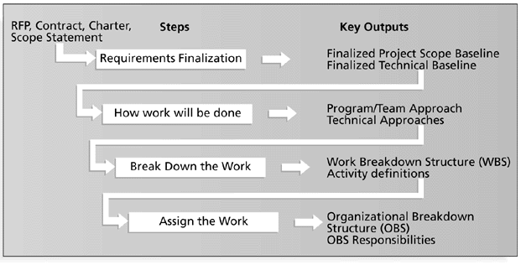
Work Definition and Assignment Process

Slide 50
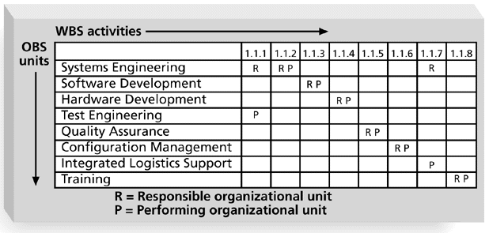
Sample Responsibility Assignment Matrix (RAM)

Slide 51
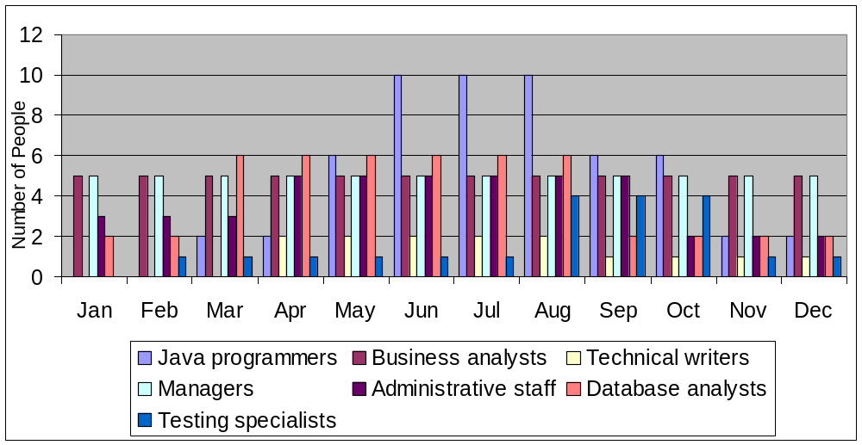
Sample Resource Histogram for a Large IT Project

Slide 52
Staff Acquisition
Staffing plans and good hiring procedures are important in staff acquisition, as are incentives for recruiting and retention
Some companies give their employees one dollar for every hour a new person they helped hire works
Some organizations allow people to work from home as an incentive
Research shows that people leave their jobs because they don’t make a difference, don’t get proper recognition, aren’t learning anything new, don’t like their coworkers, and want to earn more money

Slide 53
Resource Loading and Leveling
Resource loading refers to the amount of individual resources an existing project schedule requires during specific time periods
Resource histograms show resource loading
Over-allocation means more resources than are available are assigned to perform work at a given time

Slide 54
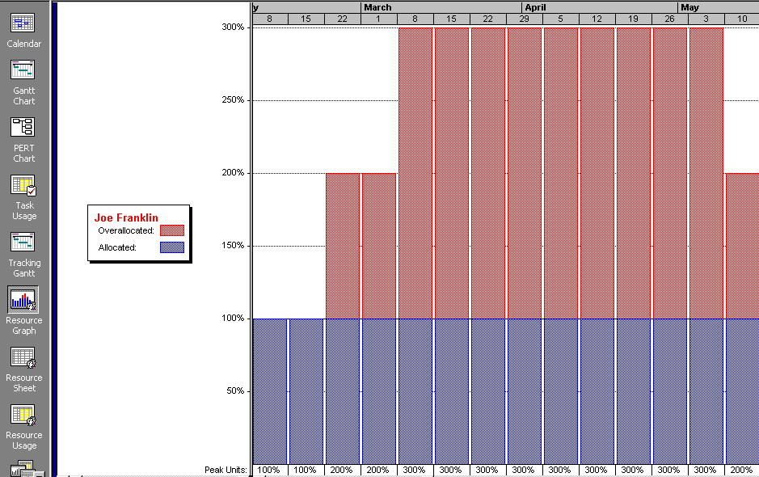
Sample Histogram Showing an Overallocated Individual

Slide 55
Resource Leveling
Resource leveling is a technique for resolving resource conflicts by delaying tasks
The main purpose of resource leveling is to create a smoother distribution of resource usage and reduce overallocation

Slide 56
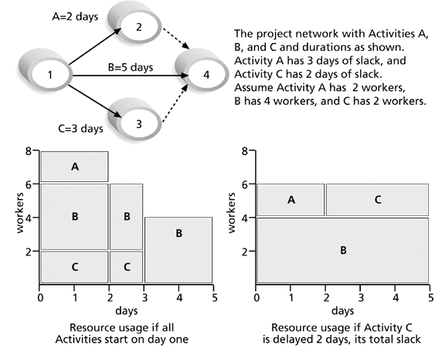
Resource Leveling Example

Slide 57
Team Development
It takes teamwork to successfully complete most projects
Training can help people understand themselves, each other, and how to work better in teams
Team building activities include
  physical challenges
  psychological preference indicator tools

Slide 58
Meyers-Briggs Type Indicator (MBTI)
MBTI is a popular tool for determining personality preferences and helping teammates understand each other
Four dimensions include:
  Extrovert/Introvert (E/I)
  Sensation/Intuition (S/N)
  Thinking/Feeling (T/F)
  Judgment/Perception (J/P)
NTs or rationals are attracted to technology fields
IT people vary most from the general population in not being extroverted or sensing

Slide 59
Reward and Recognition Systems
Team-based reward and recognition systems can promote teamwork
Focus on rewarding teams for achieving specific goals
Allow time for team members to mentor and help each other to meet project goals and develop human resources

Slide 60
General Advice on Teams
Focus on meeting project objectives and producing positive results
Fix the problem instead of blaming people
Establish regular, effective meetings
Nurture team members and encourage them to help each other
Acknowledge individual and group accomplishments

Slide 61
Using Software to Assist in Human Resource Management
Software can help in producing RAMS and resource histograms
Project management software includes several features related to human resource management such as
  viewing resource usage information
  identifying under and over-allocated resources
  leveling resources

Slide 62
Project Resource Management Involves Much More Than Using Software
Project managers must
  Treat people with consideration and respect
  Understand what motivates them
  Communicate carefully with them
Goal is to enable project team members to deliver their best work

